Slide 1
Distributed Notification System

Slide 2
Contents
1. Requirement Gathering
2. Capacity Estimation
3. High-Level Design
4. Database Design
5. Deep Dive into Key Components
6. Address Key Issues and Bottlenecks

Slide 3
1. Requirement Gathering
A notification is more than just mobile push notification. Three types of notification formats are: mobile push notification, SMS message, and Email.
Functional Requirements
  Notification Types - Push notification, SMS message, and email.
  Soft real-time system - if the system is under a high workload, a slight delay is acceptable.
  Supported devices - iOS devices, android devices, and laptop/desktop
  What triggers notifications - client applications
  Will users be able to opt-out - Yes.
  How many notifications are sent out each day -
    10 million mobile push notifications,
    1 million SMS messages,
    5 million emails.

Slide 4
Non Functional Requirements
  Scalable (Supports an arbitrarily high number of publishers, topics, subscribers)
  Highly Available (survives hw/network failure, no SPoF)
  Highly Performant (keep end to end latency as low as possible)
  Durable (messages must not be lost, each subscriber must recieve message atleast once).

Slide 5
2. Capacity Estimation

Slide 6
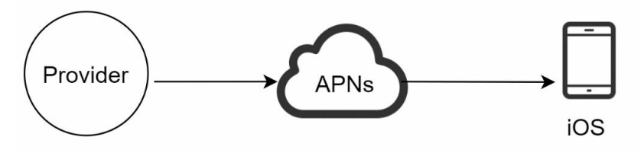
3. High Level Design
Before we goto high level design, we should check how each type of notification works.
1. iOS push notification
  We primary need three components to send an
  iOS push notification:
  1. Provider - A provider builds and sends notification requests to Apple Push Notification Service (APNS). To construct a push notification, the provider provides the following data:
  a. Device token: This is a unique identifier used for sending push notifications.
  b. Payload: This is a JSON dictionary that contains a notification’s payload.
  2. APNS: This is a remote service provided by Apple to propagate push notifications to iOS devices.
  3. iOS Device: It is the end client, which receives push notifications.

Slide 7
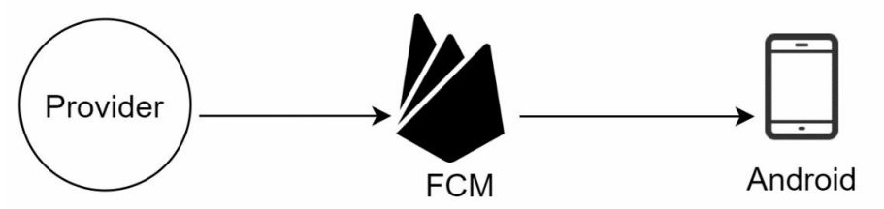
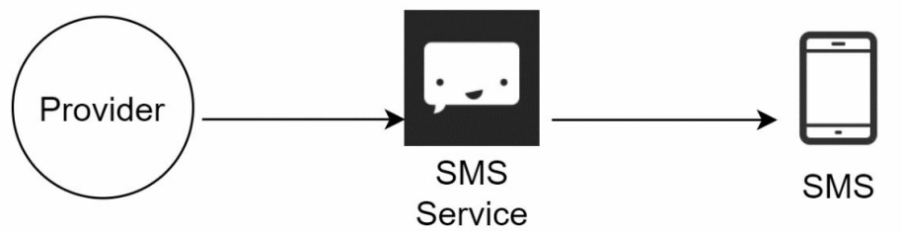
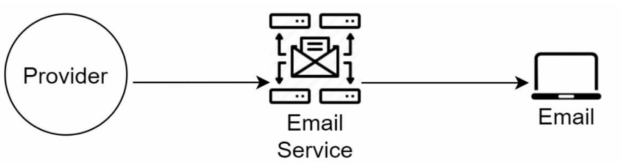
2. Android push notification
Android push notification Android adopts a similar notification flow. Instead of using APNs, Firebase Cloud Messaging (FCM) is commonly used to send push notifications to android devices.
3. SMS
For SMS messages, third party SMS services like Twilio, Nexmo, and many others are commonly used.
4. Email
Email Although companies can set up their own email servers, many of them opt for commercial email services. Sendgrid and Mailchimp are among the most popular email services, which offer a better delivery rate and data analytics.

Slide 8
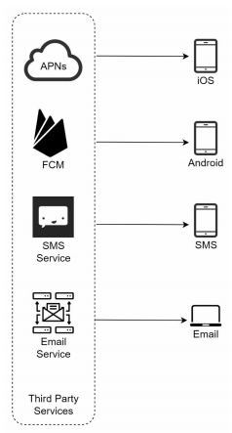

Slide 9
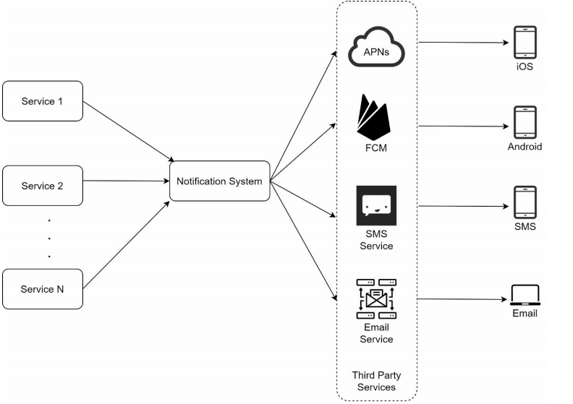
A High Level Design
Service 1 to N: A service can be a micro-service, a cron job, or a distributed system that triggers notification sending events. For example, a billing service sends emails to remind customers of their due payment or a shopping website tells customers that their packages will be delivered tomorrow via SMS messages.
Notification system: The notification system is the centerpiece of sending/receiving notifications. Starting with something simple, only one notification server is used. It provides APIs for services 1 to N, and builds notification payloads for third party services.
Third-party services: Third party services are responsible for delivering notifications to users.
iOS, Android, SMS, Email: Users receive notifications on their devices.

Slide 10
Design Flaws
Single point of failure (SPOF): A single notification server means SPOF.
Hard to scale: The notification system handles everything related to push notifications in one server. It is challenging to scale databases, caches, and different notification processing components independently.
Performance bottleneck: Processing and sending notifications can be resource intensive. For example, constructing HTML pages and waiting for responses from third party services could take time. Handling everything in one system can result in the system overload, especially during peak hours.
Security - there is no way to authenticate the requests coming to the system.

Slide 11
High-level design (improved)
After enumerating challenges in the initial design, we improve the design as listed below:
Add more notification servers and set up automatic horizontal scaling.
Add a Load Balancer infront of the notification servers.
Move the database and cache out of the notification server.
Introduce message queues to decouple the system components.
Create an Auth Service to authenticate requests

Slide 12
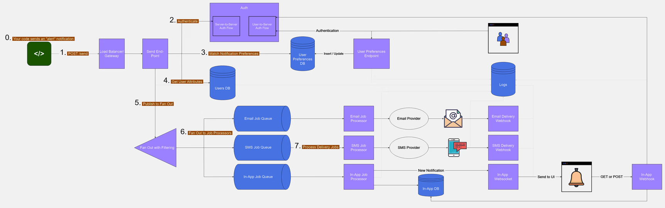

Slide 13
Your code calls the POST /send endpoint. The request contains the recipient's userId, the type of notification, and the notification contents for every supported channel.
The /send end-point authenticates the request using OAuth2's Client Credentials Flow (involves an application exchanging its application credentials, such as client ID and client secret, for an access token.)
It then requests the user's notification preferences from the database. The preferences indicate whether the user is subscribed to a particular notification and channel or not.
It will read the user attributes such as email address or phone number from the database.
This end-point will form a message object containing user attributes from step (4), along with the channels and content for each channel. However, it will exclude disabled channels based on step (3). Finally, the message is sent to a fan out service.
The fanout service is configured to broadcast incoming messages to job queues. However, there is filtering in place to ignore job queues related to channels that are not listed inside the message.
There is a job queue and processor per channel. The processor picks up the job and requests the appropriate service, e.g., a transactional email or SMS service.

Slide 14
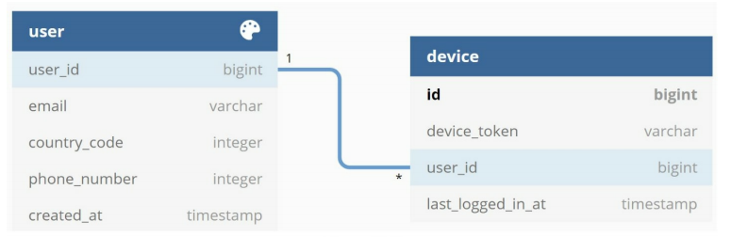
4. Database Design
Users Db (SQL)
Email addresses and phone numbers are stored in the user table, whereas device tokens are stored in the device table. A
user can have multiple devices, indicating that a push notification can be sent to all the user devices.
Users Preference Db (Key Value Store)
KEY: user_id:notification_type,
VALUE: [ {channel: "email", opt_in: true},
{channel: "sms", opt_in: false}
]‍

Slide 15
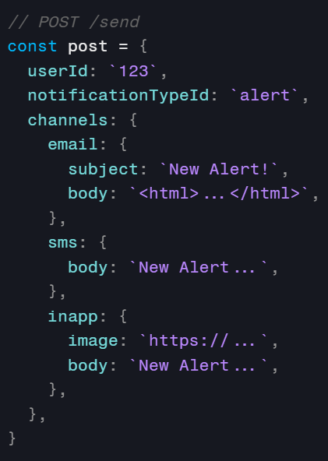
5. Design Deep Dive
1. POST /sent
The end-point is behind a load balancer to ensure scalability.
The end-point is not protected with your regular user-facing authentication.
Since the service that makes the request is a "program" itself, you need to use a different authentication mechanism known as the OAuth2 Client Credential Flow used for server-to-server communication.
You notice that the request to this end-point only contains the userId and not the email or phone number.
This allows the services that send notifications to have no knowledge of your users.

Slide 16
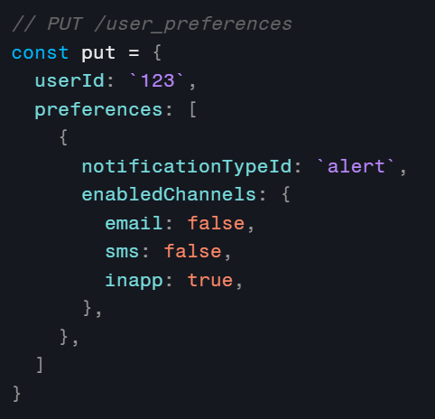
User Preferences Service
Use a highly scalable NoSQL or key/value pair database. Structure the records as:
KEY: user_id:notification_type,
VALUE: [ {channel: "email", opt_in: true},
{channel: "sms", opt_in: false}
]‍
When the send end-point sees "false" values in the records, it will remove the related channel from the message sent to the fanout. If a record for a channel does not exist, it means the user has not explicitly set their preferences. In this case, you need to agree to a default.
The information in the user_preferences table is updated by the user through your UI, through a normal end-point protected by your common authentication mechanisms.

Slide 17
User Preference Db Consideration
We dont need ACID transactions
We dont need to run complex queries
We donot want to use the storage for data analytics and warehousing.
We need a db that is scalable, highly available and tolerate network partitions.
So SQL or NoSQL? - ans: above requirements are met by NoSQL.
Type of NoSQL?
  Messages have a limited size like 1MB. So we donot need a document store.
  There is no specific relationship between messages. So we donot need graph dbs
  So we can use either column or key - value dbs.
    Ex - Apache Cassandra, Amazon DynamoDb

Slide 18
Fan Out
Fanout takes a message and duplicates it to various places. They are cheap and highly scalable. In AWS, use SNS. In Google Cloud Platform, use Pub/Sub, and in Azure, use topics and subscriptions.
You can configure filtering between the fanout and job queues to avoid sending unnecessary messages to job queues of channels that have been excluded. For example, in AWS SNS, you can specify that the email job queue should only receive the fanout message if the message contains the "email" property inside the "channels" property.
Why do we need a fanout?
You could write code that puts the same message into the necessary job queues, but fanout is cheaper, and writing less code is good. Another benefit of fanout is being able to easily add/remove queues, thus allowing you to refactor and extend your channels.

Slide 19
Job Processing
Queues hold on to messages until your job processors process them. They are also cheap and highly scalable. Job processors are code that takes messages from the job queues and processes them. They can scale based on the number of messages in the queue.
In our case, the job processor should make an API call to the appropriate service to send out the notification through a transactional email service.
Why do we need job queues and processors?
Multiple reasons:
  A) External delivery services are generally slow. The queue mechanism allows you to process these dead jobs asynchronously from the rest of your code.
  B) The queue mechanism allows you to control the rate of your jobs, thus avoiding getting throttled.
  C) These external services could face outages. A job queue mechanism lets you decide what to do in cases of job failure without a single line of code, e.g., retry the job every 30 minutes for a maximum of 3 times.

Slide 20
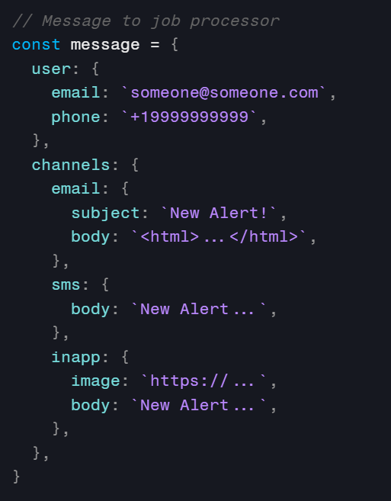

Slide 21
Websockets & Webhooks
Websockets are similar to API, but have a key difference - they stay live, so servers can constantly send information through them, instead of relying on clients sending requests to the API.
This makes websockets a go-to solution when handling in-app notifications or other services that require live updates. Effective in-app notifications require a websocket connection to ensure new notifications are delivered to users without the need to refresh the web page.
Also very similar to API, webhooks differ because they wait for events to happen. Your email provider can call a webhook to inform you that an email was delivered or bounced and the contents of that request can be logged for deliverability records.

Slide 22
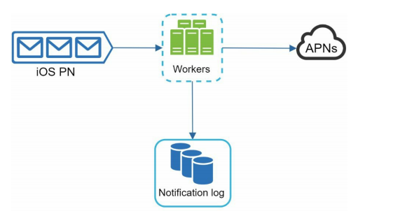
Reliability
How to prevent data loss?
One of the most important requirements in a notification system is that it cannot lose data. Notifications can usually be delayed or re-ordered, but never lost.
To satisfy this requirement, the notification system persists notification data in a database and implements a retry mechanism.
The notification log database is included for data persistence

Slide 23
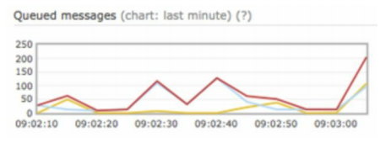
Atleast Once Delivery
Will recipients receive a notification exactly once?
The short answer is no. Although notification is delivered exactly once most of the time, the distributed nature could result in duplicate notifications. To reduce the duplication occurrence, we introduce a dedupe mechanism and handle each failure case carefully.
Here is a simple dedupe logic: When a notification event first arrives, we check if it is seen before by checking the event ID. If it is seen before, it is discarded. Otherwise, we will send out the notification.
Observability
Monitor queued notifications. A key metric to monitor is the total number of queued notifications. If the number is large, the notification events are not processed fast enough by workers. To avoid delay in the notification delivery, more workers are needed.

